Slide 1
Evolution Of Standards
Shahina Anwarul
sanwarul@ddn.upes.ac.in

Slide 2
Evolution
In 1867, the streets of London were crowded with the horse wagons and people caused by the intersection of roads.
The parliament felt a need to control the chaos and approached London Board of Works (LBOW) for a solution.
The LBOW wanted to adopt the signalling system which was employed by railway.
Therefore, they appointed JP Knight, who had worked for the railway signalling to address the road congestion issue.
The result was the appearance of the first known traffic signal in London in 1868 near the Houses of Parliament.

Slide 3
Evolution
The modern traffic signal lights use the same traffic light colours “red” and “green” that was employed in the first traffic signal built by JP Knight which has become a standard today in the traffic signalling system.
However, modern traffic signal lights have matured to comprise of three colours as opposed to the original with the addition of “amber”.
In essence, standards are originated out of a necessity in the industry to address a common problem. Standards are not “cast in stone”. They are subject to change due to changes in the eco system, emergence of new technologies etc.

Slide 4
Life Cycle Followed By Open Standards

Slide 5
Different Phases Of Life Cycle
Emerge – When a new standard is under development or review, it is known to be in the emerge phase. These standards are pending evaluations by the accredited bodies and are not in use by the companies.
Example: Aero-Trains, A team of Japanese researchers have built a prototype of an Aero-train which levitates on a cushion of air.
Current - When the emerging standards are accredited and approved and are in use in the industry are known to be in the Current phase.
Example: Electric trains – Which runs on electricity

Slide 6
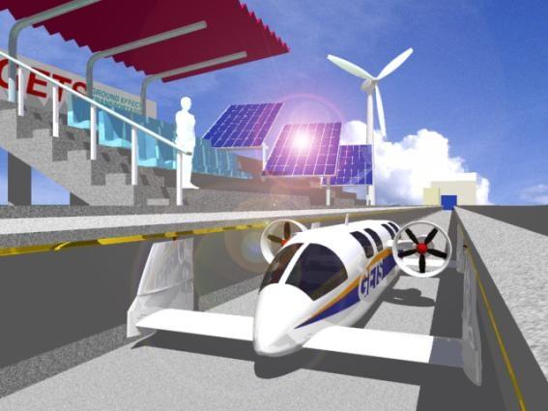
Prototype Of Aero Train

Slide 7
Different Phases Of Life Cycle
Obsolete – When the standards are not in use by the industry because of the changing environment, they are known to be Obsolete. The standards that do not change are likely to fade away with the passing of time. Such standards are generally replaced with the new standards.
Example: Railway steam locomotives
Revision - The standards evolve with the changes in the industries and attain a different level of maturity. They move through maturation driven by efficiency and value. These are successors of the existing standard with the upgraded characteristics which when adopted becomes current.
Example: Originally the rail tracks were connected using wood or concrete, which has been upgraded to use Ballast-less track.

Slide 8
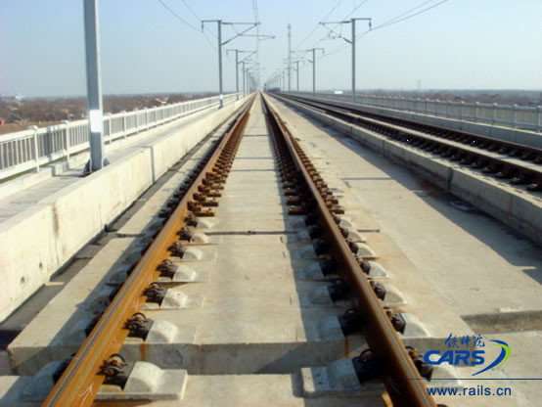
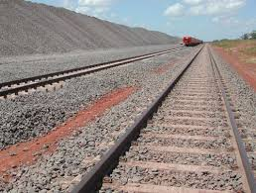
Ballast Less Track And Ballast Track

Slide 9
Importance Of Standards
The importance of standards is better explained in the railway scenario.
Indian Railways are divided into multiple regions.
If there are no well defined standards in the railway systems, each of the regions would follow their own set of standard for their gauges.
In this scenario, imagine the difficulties of a person who wants to travel from Mumbai to Kolkata.
Mumbai belongs to Central region and Kolkata to Eastern region. Let’s say central region standardized their entire gauge on “Broad gauge” which is 5 feet 6 inches and Eastern region standardized on “Metre gauge” which is 2 feet 6 inches.
The person traveling from Mumbai to Kolkata must switch trains to reach the destination.

Slide 10
Importance Of Standards
This will bring a bigger challenge of having different size bogies and railway engines.
Therefore, adopting a single standard gauge across the Indian Railways will not only negate the repercussions but also helps in;
Interoperability
Increases Efficiency
Economical
Better service
Increases reuse

